Slide 1

Computer Graphics and Image Processing
Geometry III

Slide 2
Today’s Outline
Homogeneous Coordinates
3D Affine Transformations
Examples

Slide 3

Homogeneous Coordinates

Slide 4
Homogeneous Coordinates
Affine transformation F consists of a linear transformation and a translation: F(p) = M p + t
Can we get rid of the vector addition so that F(p) = M p works even for translations?
Wanted: Representation of translations as matrices
Solution: Homogeneous Coordinates
Add an additional coordinate to every vector, which is set to 1 if the vector can be translated
Normally we just ignore the additional coordinate
Also add another row and column to our matrices, e.g.

Slide 5
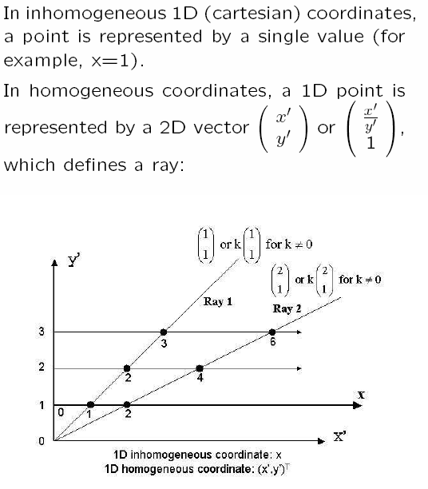
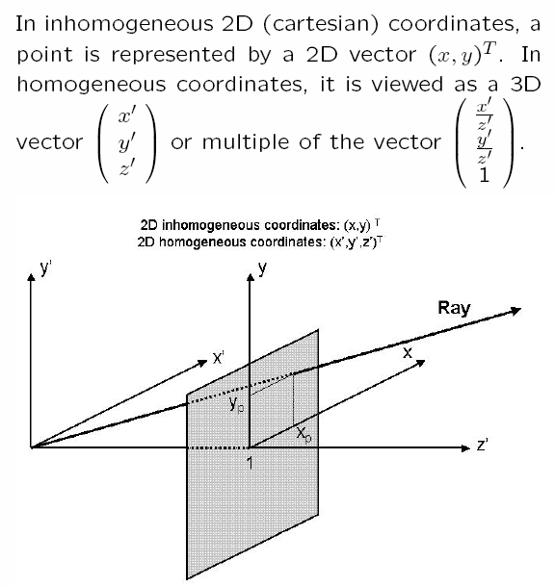
Homogeneous coordinate 1D-2D

Slide 6
Using Homogeneous Coordinates
Every vector gets an additional coordinate with value 1 (if translations should affect the vector, otherwise 0)
Every matrix gets an additional row and column (0, …, 0, 1)
For transformations other than translations: no difference
Now we can formulate translations as matrices T:

Slide 7
Converting Coordinates
Ordinary to Homogeneous Coordinates:
Just add another coordinate (often called w-coodinate)
w=1 if translations are possible, w=0 if not
Homogeneous to Ordinary Coordinates:
Divide all other coordinates by w-coordinate (if w ≠ 0)
All homogenous 2D coordinate points (w p₁, w p₂, w)^{T} with w ≠ 0 represent the same ordinary coordinate point (p₁, p₂)^{T}
Usually w=1, so conversion means just omitting the w-coordinate

Slide 8
Conversion example
Example: the 3D point (5, 3, 2)^{T} has the homogeneous representation (5λ, 3 λ, 2 λ, λ )^{T} with arbitrary factor λ ≠ 0, e.g., (5, 3, 2, 1)^{T}, or (15, 9, 6, 3)^{T}, or (−55,−33,−22,−11)^{T} and so on.
Conversely, the homogeneous vector (30, 10, 15, 5)^{T} represents the point (6, 2, 3).
In homogeneous coordinates projective transformations as well as affine transformations (e.g. translations, rotations, scaling) are specified by linear equations.

Slide 9

3D Affine Transformations

Slide 10
3D Affine Transformations
Mostly analogous to 2D
Now we use homogeneous coordinates, i.e. all transformations are represented as a matrix M that can be left-multiplied: M v
Translation T by a vector t = (t_{x}, t_{y}, t_{z})^{T}
Similar to identity matrix
Rightmost column contains t
Scaling S about origin with scaling factors s_{x}, s_{y}, s_{z}
Similar to identity matrix
Diagonal contains scaling factors
A negative s_{x}, s_{y} or s_{z} causes reflection on the x=0, y=0, or z=0 plane

Slide 11
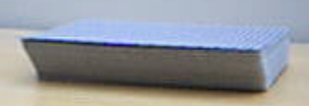
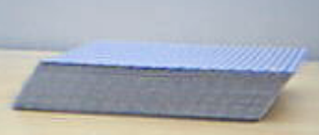
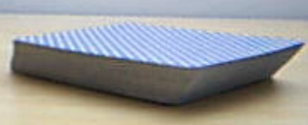
Shearing
General shearing H:
Any coordinate (x/y/z) can linearly influence any other coordinate
h_{yx} epresses how much y influences x
Examples:
y
h_{yz} > 0 and all others 0
h_{yx} > 0 and all others 0
z
x
y
y
Both together, i.e. h_{yx} > 0 and h_{yz} > 0 and all others 0
z
x
z
x

Slide 12


Rotation
Rotations are the most difficult transformations
We will consider three different rotation situations:
Rotation around the three coordinate axes (x, y, z)
Rotation to align an object with a new coordinate system
Rotation around an arbitrary axis
We use a right-handed coordinate system
We use positive (right-handed) rotation, i.e. counterclockwise when looking into an axis
y
z
x
Direction of rotation
Axis of rotation

Slide 13
Rotation around Coordinate Axes
Three axes (x, y, z) to rotate about, so three different matrices
Let C = cos θ and S = sin θ, then the matrices for positive (right handed) rotation are:
Rotation about x-axis:
Rotation about y-axis:
Rotation about z-axis:
Note on 3 × 3 rotation matrices:
Row and column corresponding to axis of rotation are as for identity I
Other elements are C on diagonal, ± S off diagonal, so that R = I if θ = 0.
Sign of S can be inferred from the fact that rotation around x,y,z by θ=90^{ο} transforms y→z , z→x, x→y, respectively.

Slide 14
Rotating to Align with New Coordinate Axes
Wanted: matrix R that rotates the coordinate system to align with a new coordinate system (a,b,c) with the same origin
x,y,z are the unit vectors of our normal coordinate system
a,b,c are unit vectors along the axes of the new system
Solution:
R should do the following: Using homogeneous coordinates: R (1 0 0)^{T} = a R (0 1 0)^{T} = b R (0 0 1)^{T} = c
y
(0,1,0)
b
R
z
(0,0,1)
x
(1,0,0)
c
a

Slide 15
Rotation about an Arbitrary Axis
Often need to rotate an object about some arbitrary axis through a reference point on it
E.g. forearm of robot rotating around an axis through the elbow
Involves three steps:
Translate reference point to origin
Do the rotation
Translate reference point back again
Translation is easy (steps 1 and 3)
We know how to rotate about coordinate axes, but how about an arbitrary axis through the origin?
Textbook method: decompose rotation into primitive rotations about x,y and z axes
Coordinate system alignment method

Slide 16
Arbitrary Axis Rotation: Textbook
Rotate the object so that the required axis of rotation r lies along the z-axis (R_{alignZ})
Do the rotation about z-axis
Undo original rotation (R_{alignZ}⁻¹)
How to get R_{alignZ}?
Measure azimuth θ as a right handed rotation about the y-axis, starting at the z-axis
Measure elevation φ (or "latitude") as angle above plane y=0
R_{alignZ} = R_{x}(φ) R_{y}(–θ)
y
U = (u_{x}, u_{y}, u_{z})
r
φ
x
θ
z
−
1
u
y
φ
=
tan
u
2
+
u
2
x
z
θ
=
atan2
(
u
x
,
u
z
)
−
1
u
x
(i.e. a four
quadrant
tan
)
u
z

Slide 17
Arbitrary Axis Rotation: Alignment
b
Given:
Coordinate system a,b,c attached to the object we want to rotate
Position P of the object’s coordinate system
New coordinate system u,v,n to rotate object to
Solution:
Translate object to origin (T_{P}⁻¹)
Rotate a,b,c to align with world coord. axes (inverse of the "rotate to align" case: R_{abc}⁻¹)
Rotate coord. axes to align with u,v,n (R_{uvn})
Translate object back to original position (T_{P})
Full matrix is: T_{P} R_{uvn} R_{abc}⁻¹ T_{P}⁻¹
P
y
c
a
x
z
v
y
P
u
n
x
z

Slide 18
The Inverse of a Rotation Matrix
Columns of a rotation matrix are unit vectors along the rotated coordinate axis directions
So columns are orthogonal, i.e. dot products = 0
The inverse of a rotation matrix is its transpose
(matrices with this property are called orthogonal)
therefore

Slide 19
Examples

Slide 20
Composition of Transformations
All transformations can be represented as matrix M
Combine several transformations into a single matrix by multiplying all transformation matrixes: M_{n} M_{n-1} … M₁ = M
Transformation of rightmost matrix is applied first (i.e. M₁)
Example: rotating an object about its centre point C
Translate the object so that its centre is at the origin
Rotate about the origin
Translate object back to its original position

Slide 21
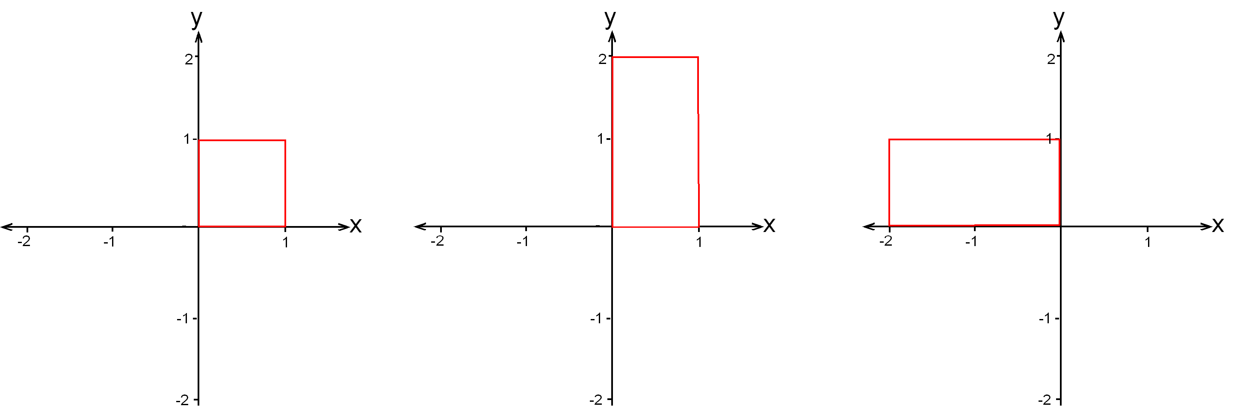
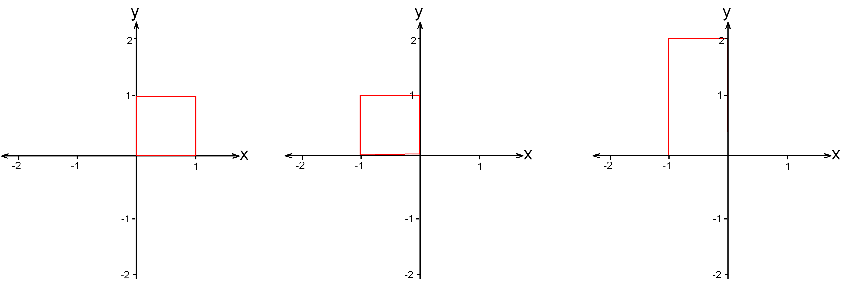
The Order of Transformations Matters!
In general affine transformations do not commute, i.e. M N ≠ N M
a) First scale by (1,2), then rotate 90º
b) First rotate 90º then scale by (1,2)

Slide 22
Exam Question 1
Which homogeneous 2D matrix M transforms (a) to (b)?
[1996 exam question]
Sometimes easier to do these backwards, then take inverse, i.e. starting with figure (b): Rotate -30º , shift by (-3,1) , scale by (1/2, 1)
Hence the required transformation is: R(30º) T(3,-1) S(2,1) (first scaling, then translation, finally rotation)
Don’t forget to use homogeneous matrices
(a)
(b)

Slide 23
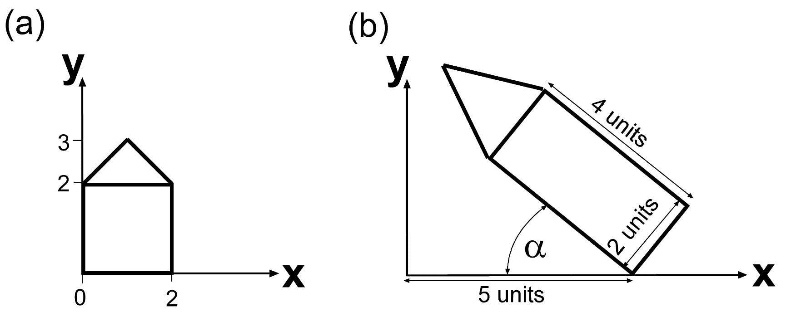
Exam Question 2
Which homogeneous 2D matrix M transforms (a) to (b)?
You are allowed to write M as a product of simpler matrices (i.e. you need not multiply the matrices) [2003 exam question]

Slide 24
SUMMARY

Slide 25
Summary
Homogeneous coordinates make it possible to represent translation as a matrix
3D Affine Transformations similar to 2D: translation, scaling, shearing and rotation
Column vectors of rotation matrix R are axis unit vectors of new coord. system to align x,y,z with
R⁻¹ = R^{T}
Transformations are applied from right to left
References:
Homogeneous Coordinates: Hill, Chapter 4.5.1
3D Affine Transformations: Hill, Chapter 5.3

Slide 26
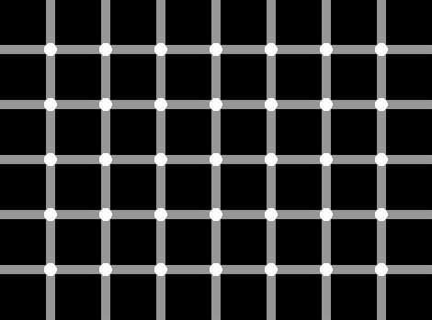
Quiz
An object has a local coordinate system a=(1,0,0), b=(0,0,-1), c=(0,1,0) at position (-10,2,5). Which homogeneous matrix rotates the object into the new coordinate system u=(0,-1,0), v=(0,0,-1), n=(1,0,0)?
Solve the sample exam questions 1 and 2.
Create your own variation of the exam questions and solve it.
Count the black dots!

